Slide 1
SolarEcon Insight: Unveiling Market Dynamics and Predicting Solar Stocks
Anastasia skaliy

Slide 2


The decision to delve into the solar industry stems from its increasing significance in the global energy landscape. With growing concerns about climate change and the transition towards renewable energy sources, understanding the dynamics and trends within the solar sector is crucial. Moreover, solar energy presents a promising avenue for sustainable development, offering environmentally friendly alternatives to traditional energy sources.

Slide 3


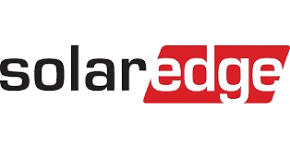
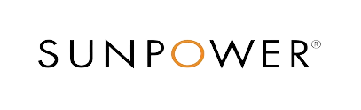
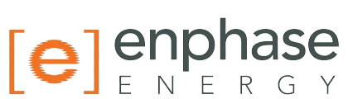
4 key companies in the solar industry
By analyzing these companies, I aim to gain insights into various aspects of the solar industry, including market trends, financial performance, and the broader impact of solar energy adoption.
I retrieved the data for financial statements and stock prices via the Yahoo Finance API.

Slide 4
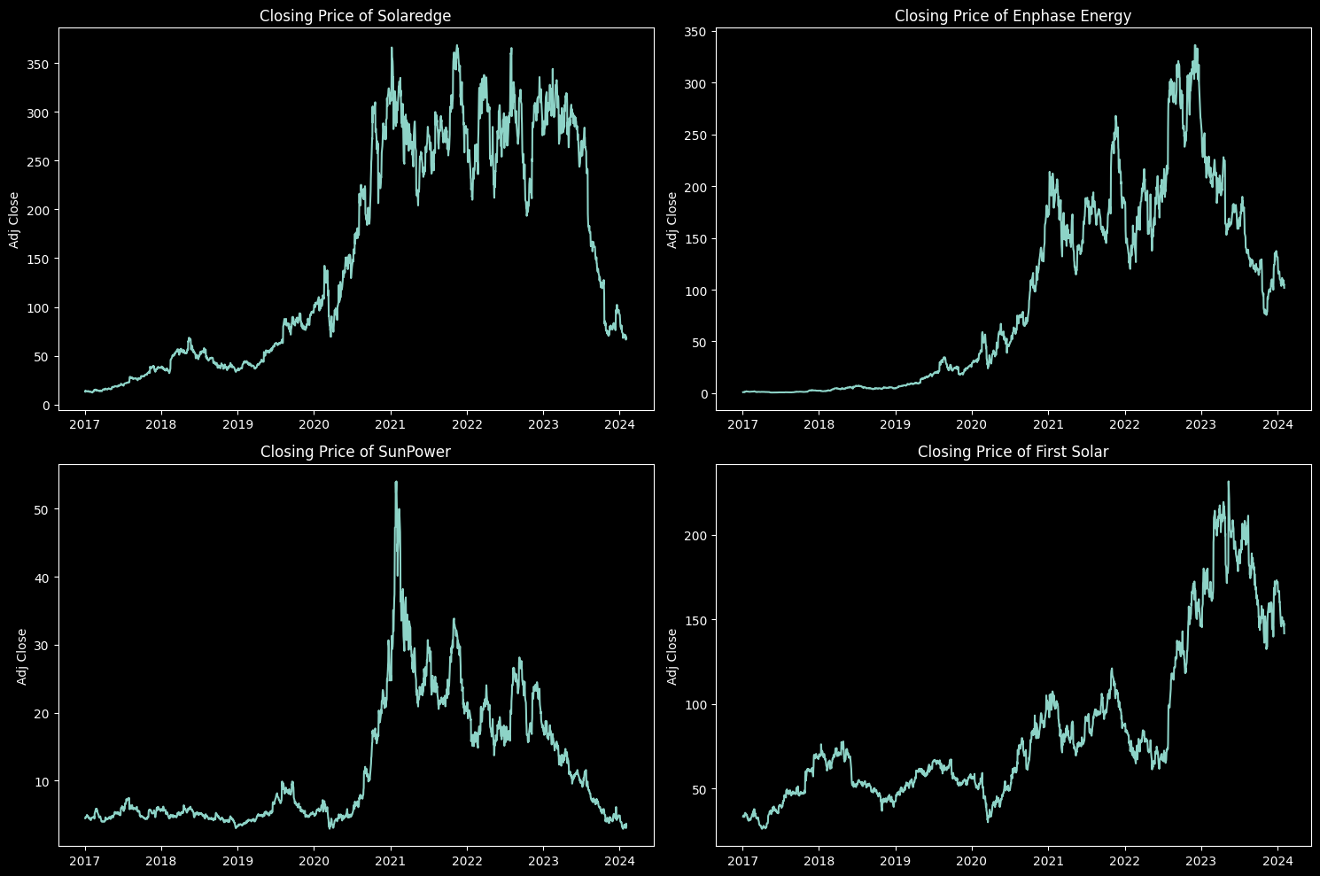
In the solar energy sector, a notable upsurge was observed from 2020 to 2021, after onset of the Coronavirus pandemic, signifying a pinnacle in the green energy industry's growth trajectory. however, after several years at the peak of the industry, in the last year, 2023 - 2024, we have seen a sharp decline in the stock

Slide 5
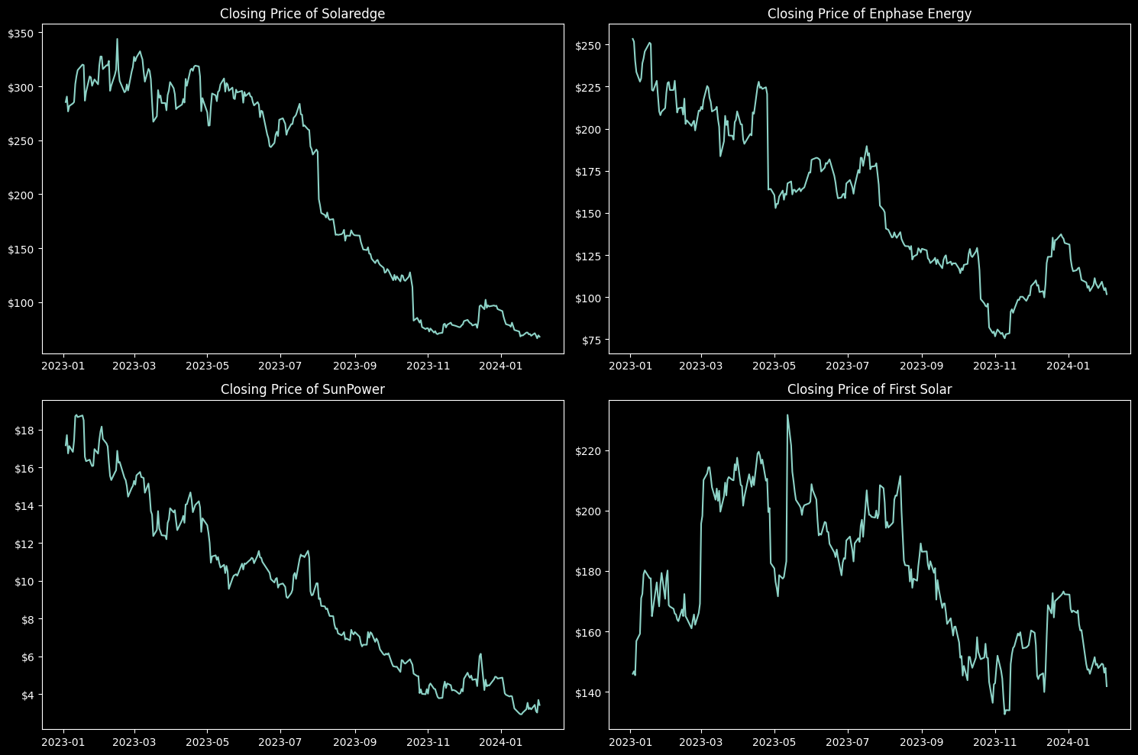
We can understand that this is a problem not only for one company, but for the entire solar industry is the world moving away from clean solar energy?

Slide 6
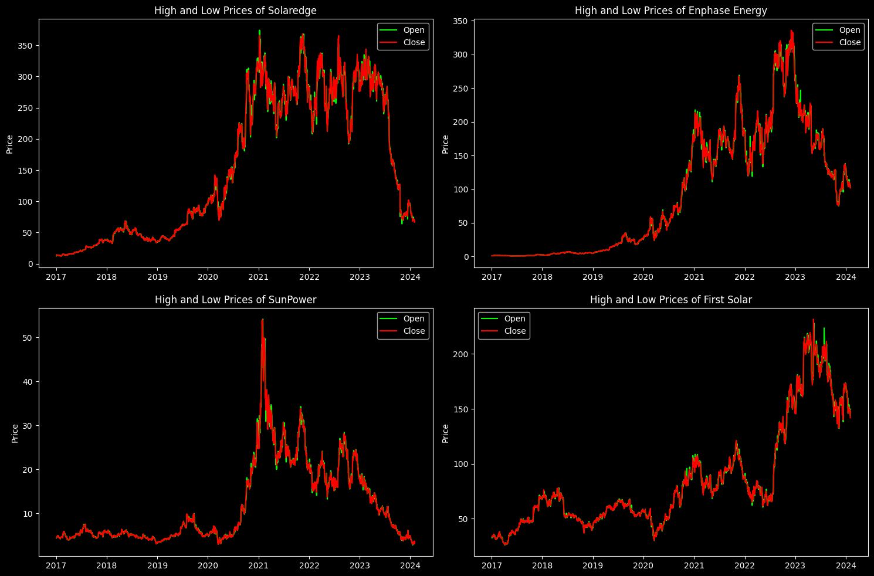
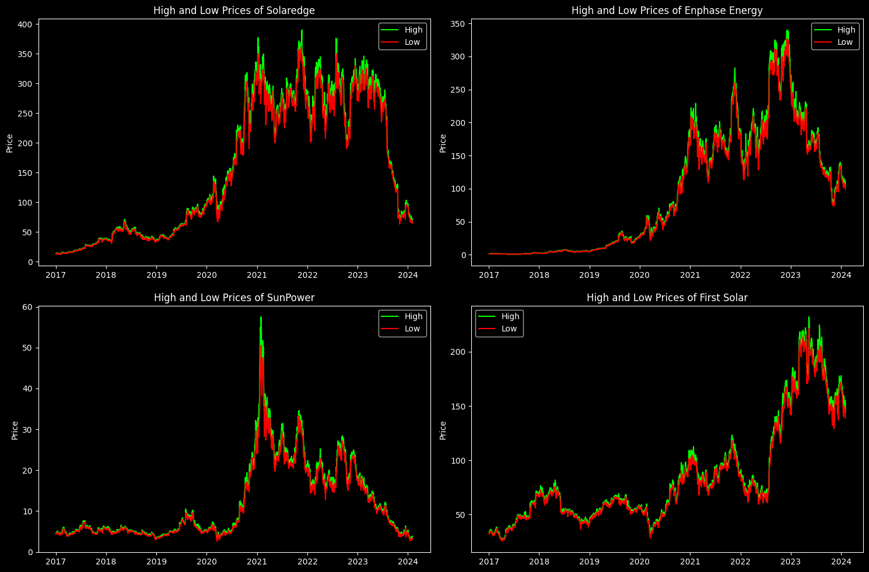
In this project we seek to ascertain the root causes of this industry-wide decline by exploring various potential factors.
On these graphs you can see candlestick for High – Low prices over time , and Open – Close prices

Slide 7
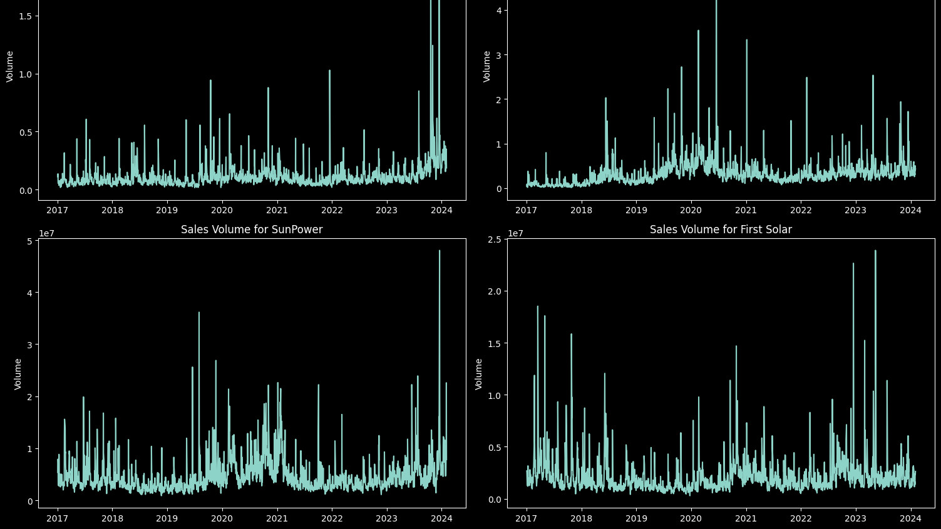
Sales volume

Slide 8
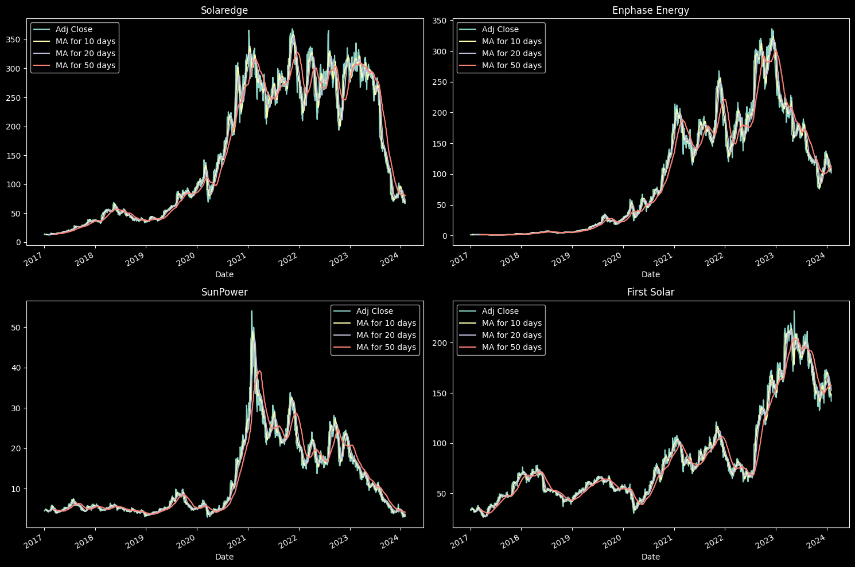
What was the moving average of the various stocks?
The best values to measure the moving average are 10 and 20 days because we still capture trends in the data without noise.
This insight suggests that these shorter-term moving averages may be more suitable for identifying meaningful patterns and trends in the stock prices.

Slide 9
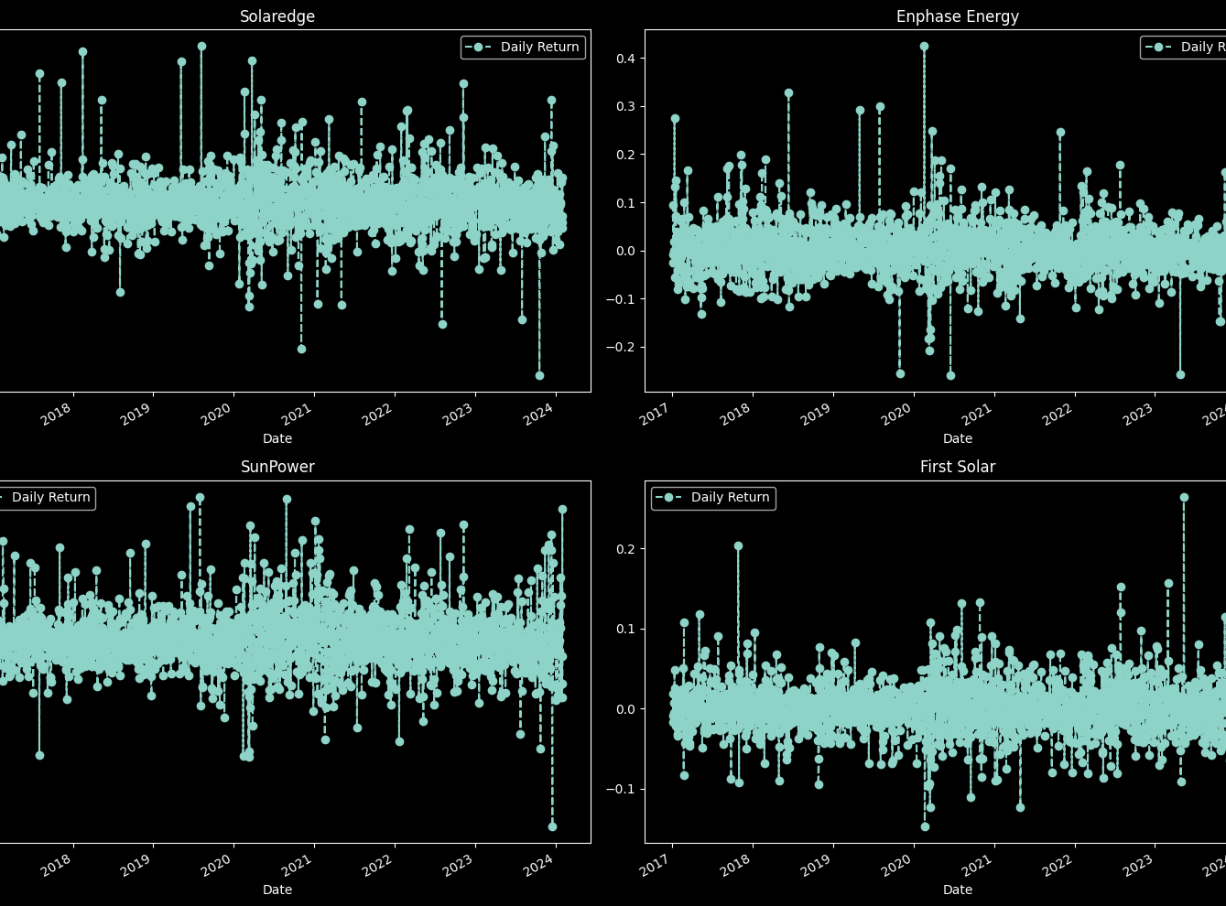
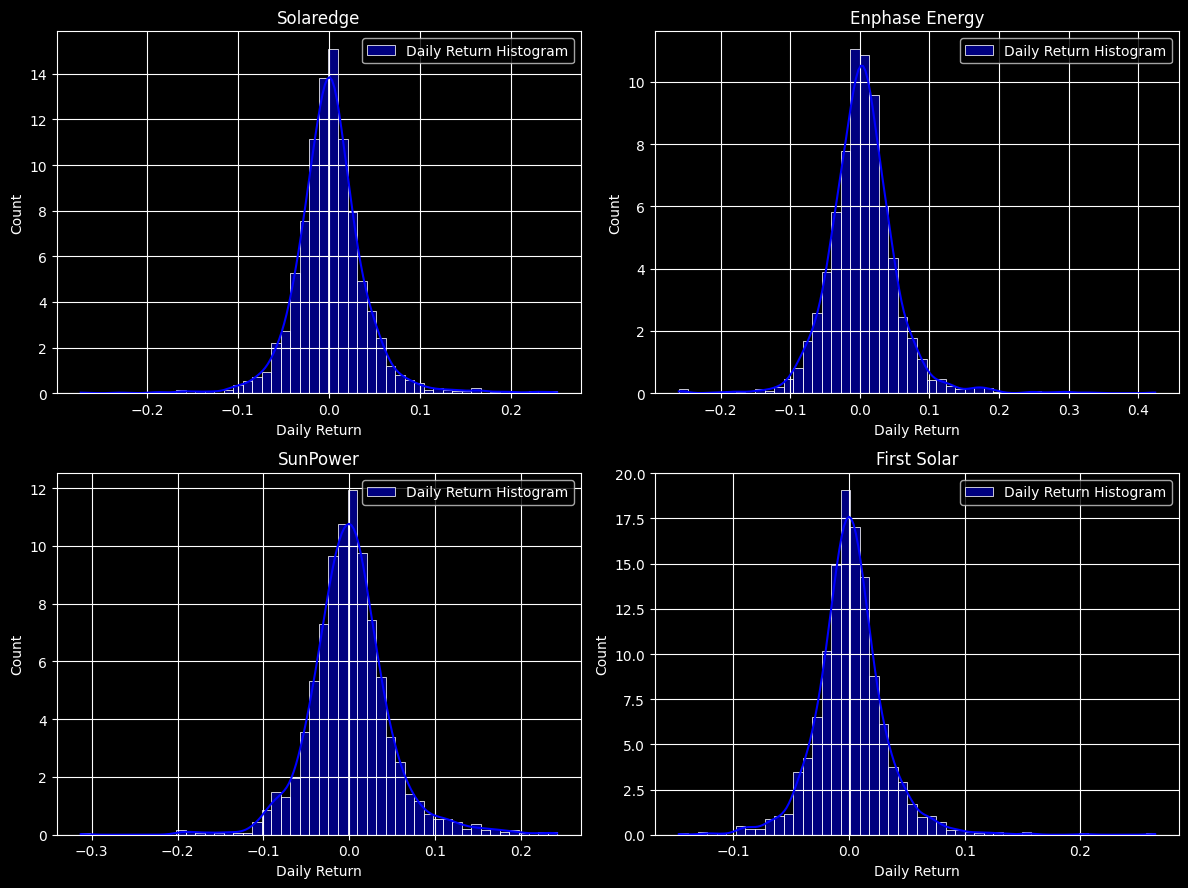
What was the daily return of the stock on average?
In Enphase Energy, we observe outliers during periods of surges in stock prices.
The plots for SolarEdge and SunPower exhibit similarities, depicting numerous days with significant price movements. It indicates for high correlation between these companies.
In the case of First Solar, the largest unusual market events are noticeable in 2018 and the first part of 2023.
Daily Return Histogram
SolarEdge and SunPower display right-skewed distributions, indicating a higher frequency of positive returns. Conversely, Enphase and First Solar exhibit left-skewed distributions, suggesting a prevalence of negative returns.
SunPower demonstrates the widest spread, indicative of higher volatility in returns. Conversely, First Solar exhibits the narrowest spread, implying lower volatility.

Slide 10
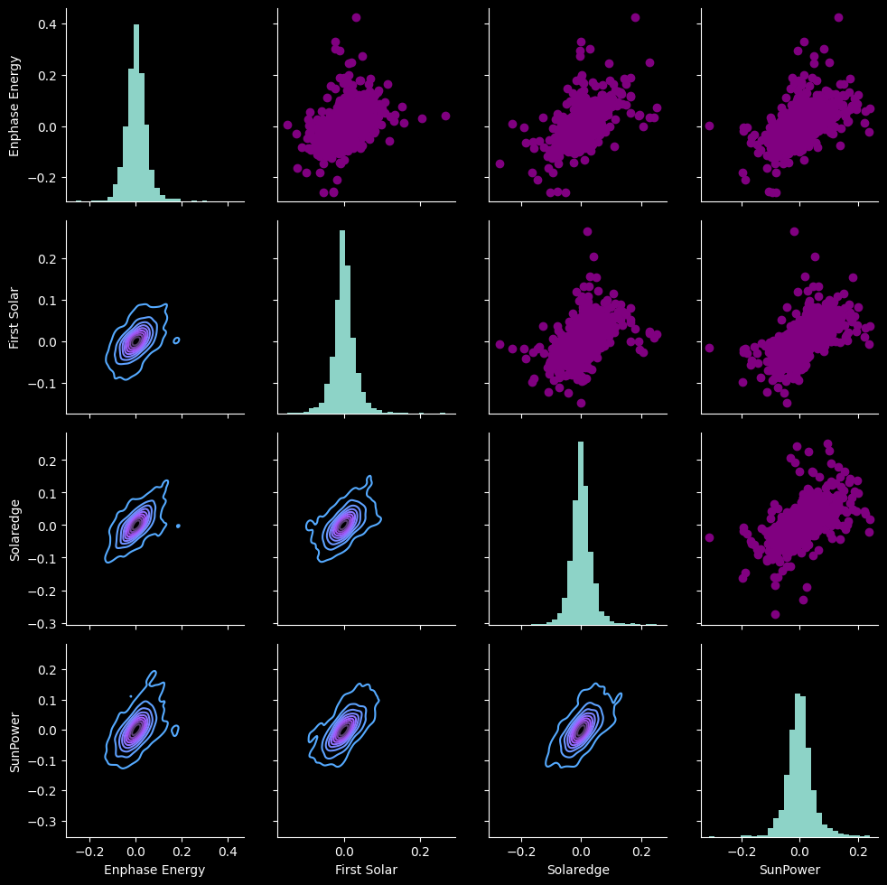
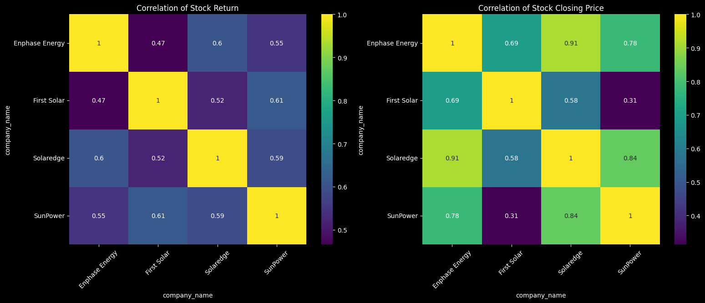
What was the correlation between different stocks closing prices and daily return?
The correlation of stock returns: In all of the companies, we can observe a strong positive correlation. The correlation of stock closing prices: We can observe a really high correlation between SolarEdge and Enphase Energy at 0.91. All other companies are positively highly correlated as well. The weakest correlation is between SunPower and First Solar at 0.31.

Slide 11
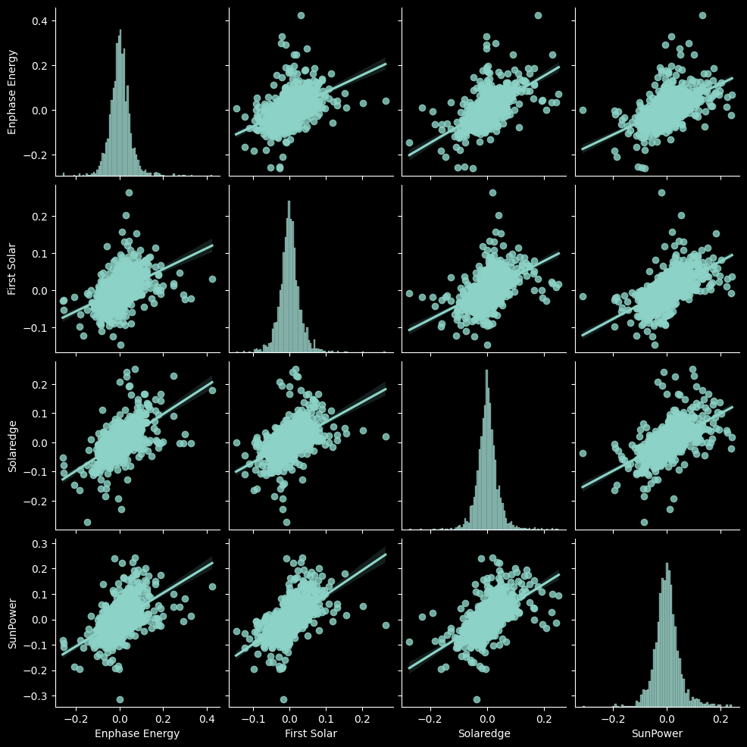
What was the correlation between different stocks closing prices and daily return?
We can observe the relationships in daily returns between all the stocks. There is a strong positive correlation between the daily returns of all the companies, as well as daily return.
When the points cluster around a straight line, it suggests a strong linear relationship
Also, we can see Mapping kernel density estimate (KDE) for daily return correlation, on the second plot

Slide 12
The correlation of stock returns: In all of the companies, we can observe a strong positive correlation. The highest correlation is between SunPower and First Solar at 0.61, while the weakest correlation is between First Solar and Enphase Energy at 0.47. The correlation of stock closing prices: We can observe a really high correlation between SolarEdge and Enphase Energy at 0.91. All other companies are positively highly correlated as well. The weakest correlation is between SunPower and First Solar at 0.31.

Slide 13
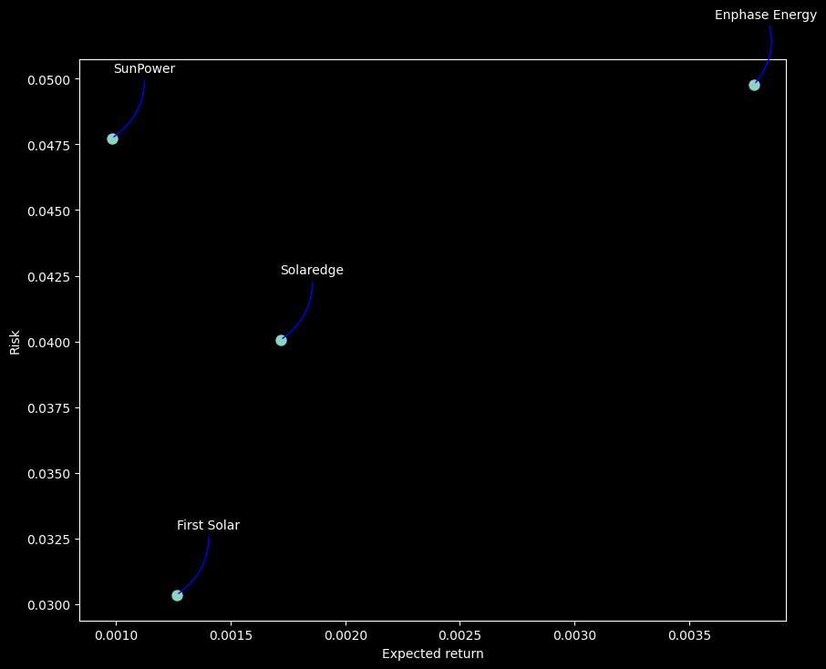
How much value do we put at risk by investing in a particular stock?
Enphase Energy exhibits the highest expected returns, accompanied by the highest level of risk.
Conversely, stocks of First Solar demonstrate lower expected returns but also lower risk.
SunPower's stocks are characterized by a low expected return coupled with very high risk.
Finally, SolarEdge exhibits a moderate level of both expected return and risk.

Slide 14
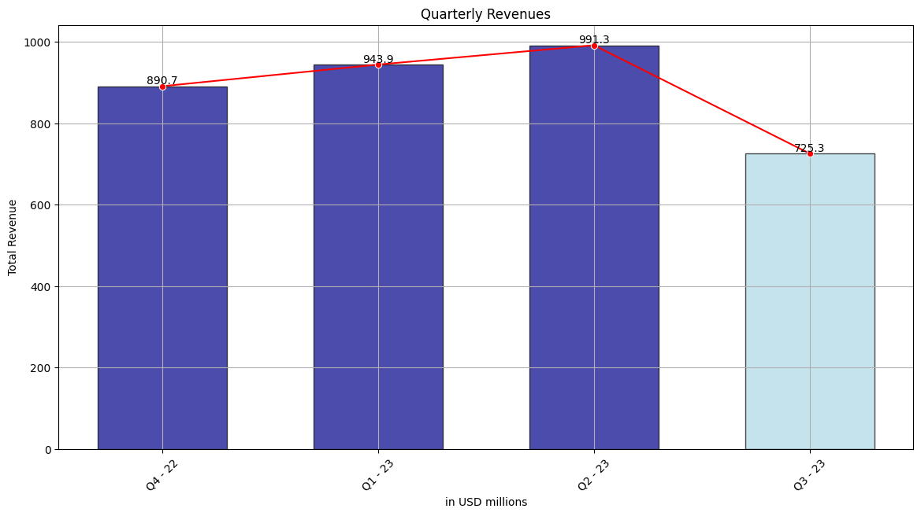
Financial statements analysis
Our analysis revealed a consistent trend across various metrics during the third quarter (Q3).
Across all analyses conducted — Profitability, Efficiency, Liquidity, Debt Management, Earnings per Share (EPS), and Operating Expense - we observed a decline in key financial metrics during Q3.

Slide 15
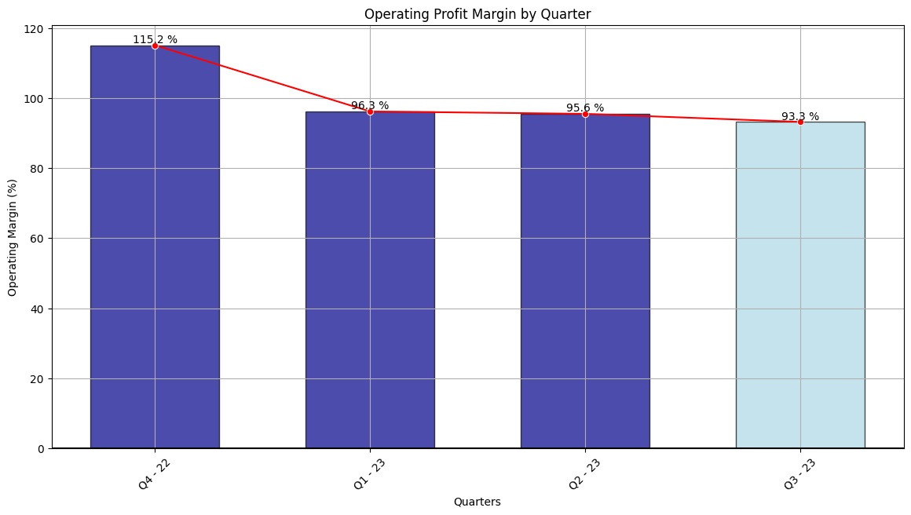
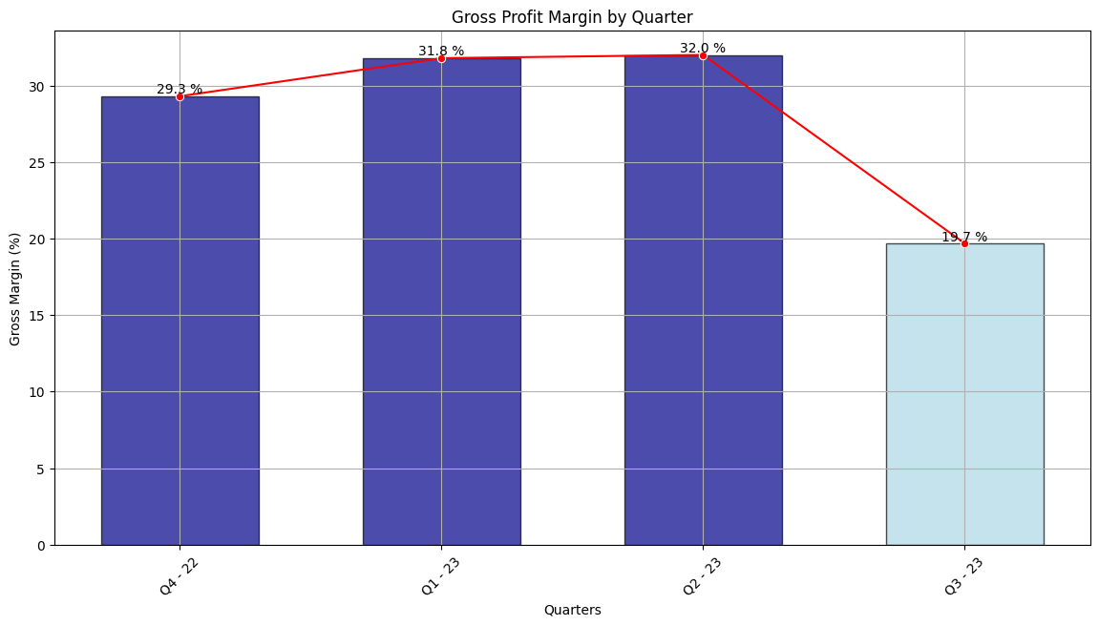
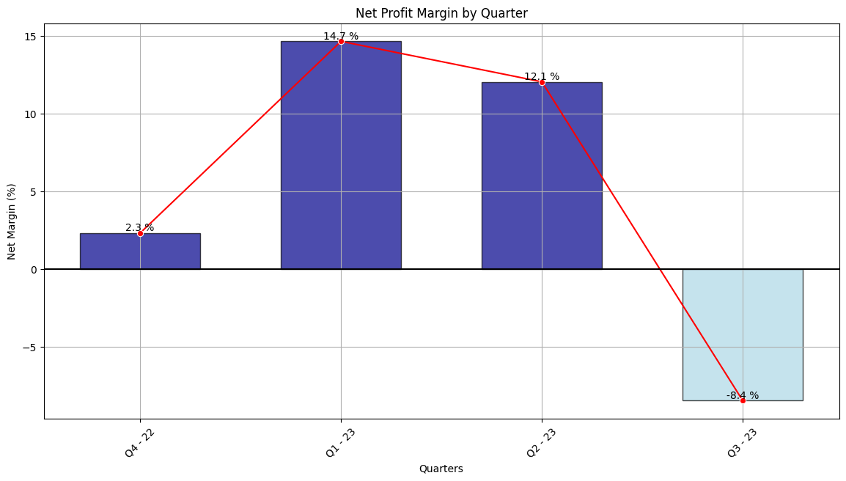
Profitability Analysis:
Gross Profit Margin - margin decreased from 32% in Q2 to 19.7% in Q3.This can be indicative of various factors, such as increased production costs, pricing pressures, or changes in sales mix.
Net Profit Margin - took a significant downturn, plummeting to -8.4%, indicating a negative profit margin. This indicates that the company incurred losses during that period, highlighting potential challenges or issues impacting its financial performance.
Operating Profit Margin - also declined, it suggests that SolarEdge's profitability from its core business activities decreased.

Slide 16
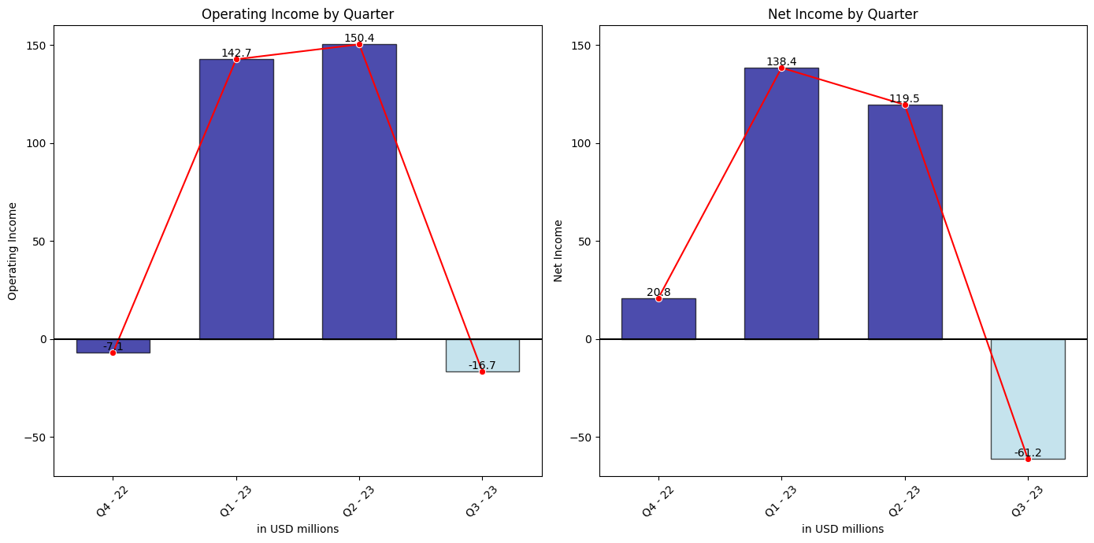
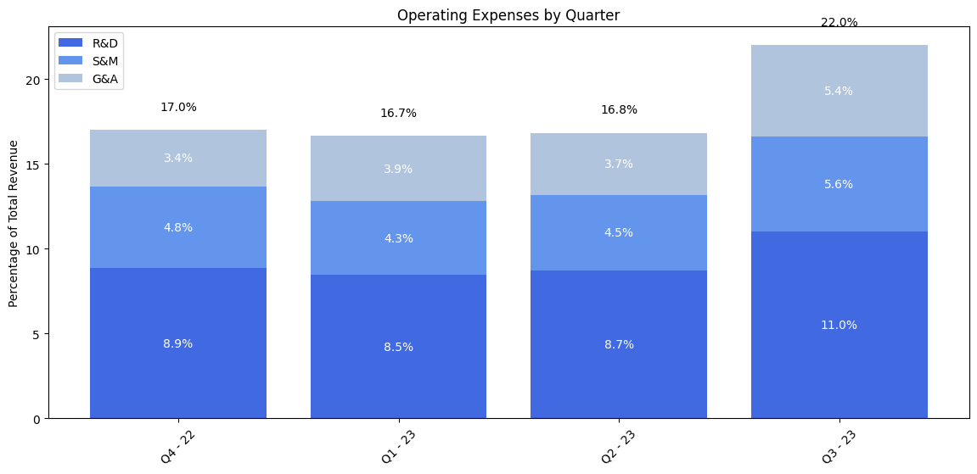
Operating Expense Analysis:
Conversely, expenses of the company increased in all departments
The operating income plummeted from a positive $150.4 million in Q2 to a negative $16.7 million in Q3. Similarly, the net income dropped from a positive $119.5 million in Q2 to a negative $61.2 million in Q3.

Slide 17
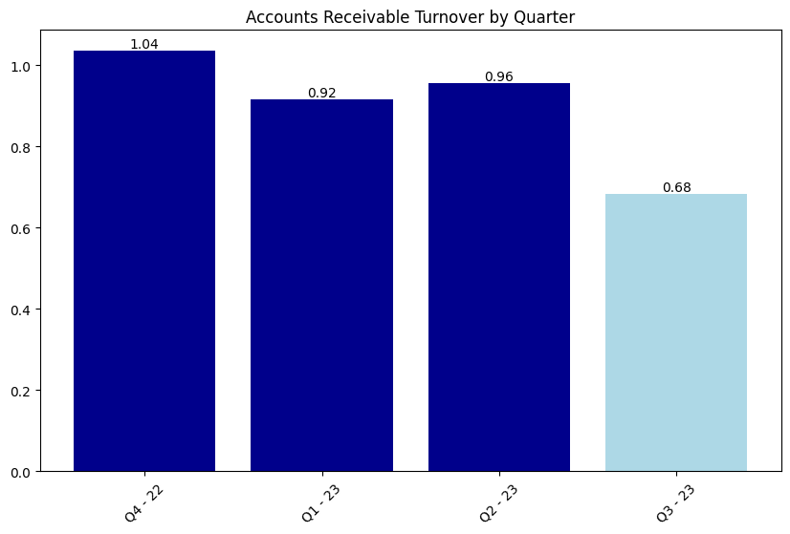
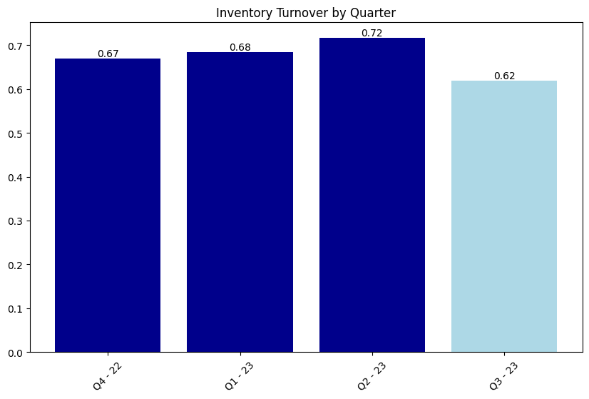

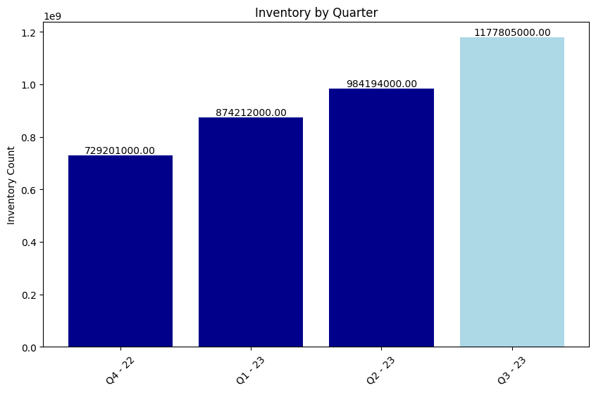
Efficiency Analysis:
A lower value for Inventory Turnover (Slow Inventory Movement, Decreased Sales)
Increase in the inventory (decline in sales)
Decrease in the Accounts Receivable Turnover (taking longer to collect payments from its customers)
Decrease in the Accounts Payable Turnover (slowdown in the company's payment cycle)

Slide 18
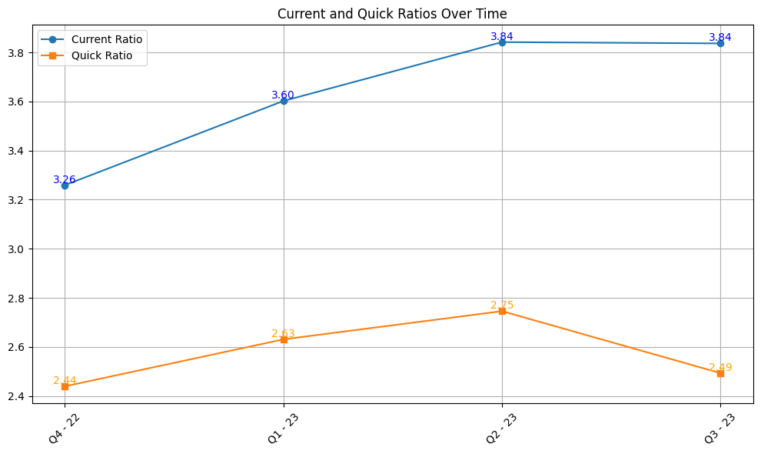
Liquidity Analysis:
In the Liquidity Analysis, we can evaluate the company's ability to meet its short-term obligations using the following ratios: Current Ratio and Quick Ratio (Acid-Test Ratio)

Slide 19
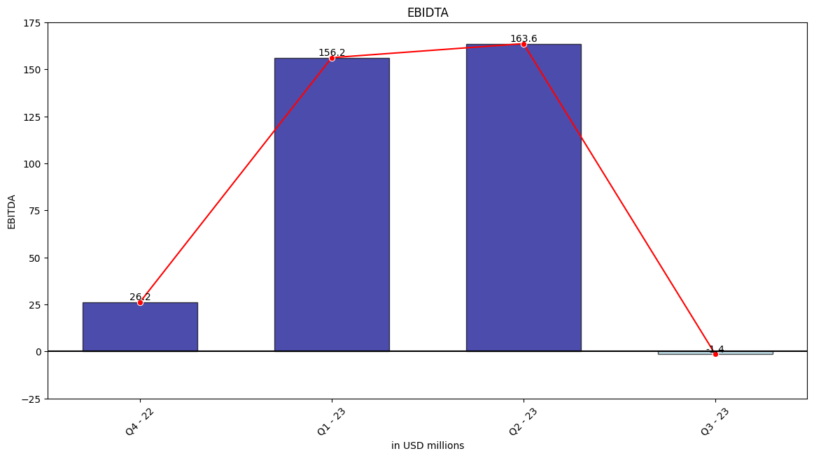
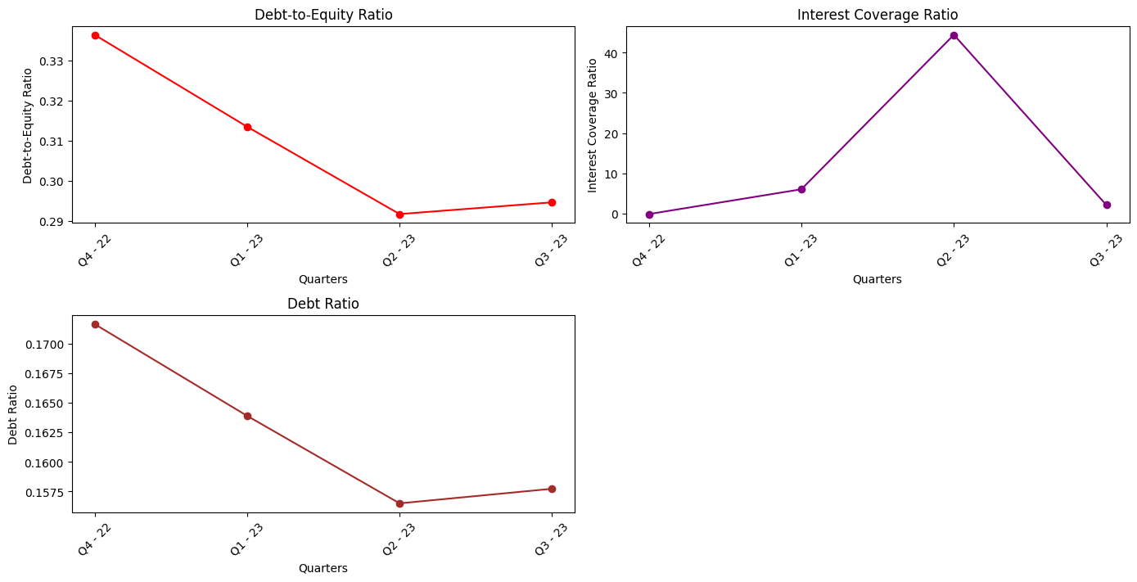
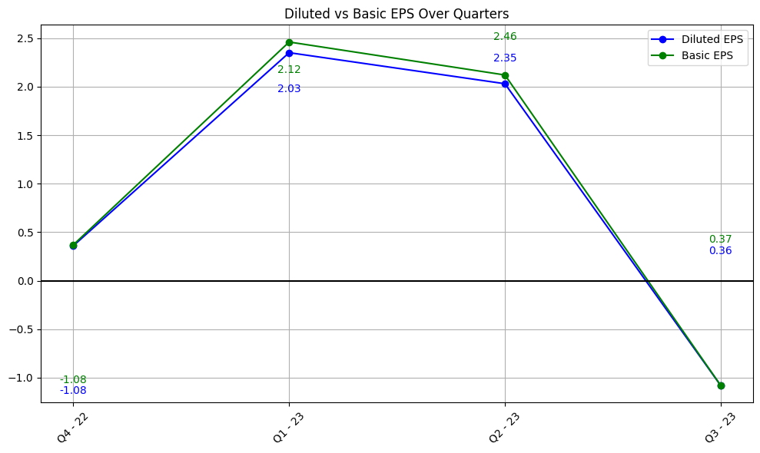
Debt Management Analysis:
EBITDA indicates how well the company
is managing its day-to-day operations
Earnings per Share (EPS)
Analysis:

Slide 20
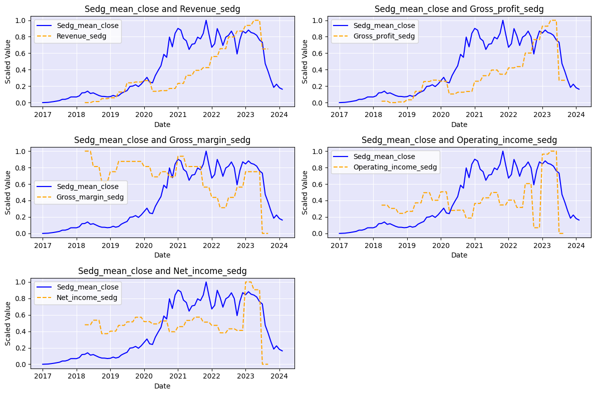
the financial statements analysis underscored the importance of monitoring key financial metrics for assessing the company's performance and predicting its stock market behavior.
There is a high positive correlation between all provided financial metrics and stock prices.
When financial indicators fell, the company’s shares also fell.

Slide 21
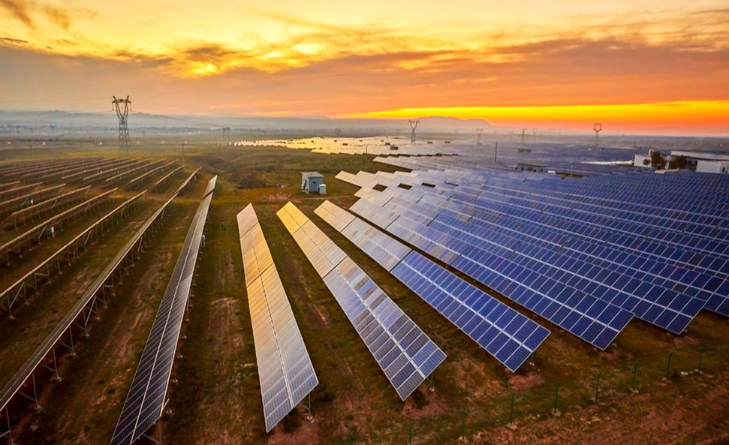
building a dataset
After conducting my research, I opted to incorporate additional factors that could potentially influence the solar industry.
I included variables such as interest rates, electricity rates, and prices for crude oil, natural gas, and coal.
I focused on two the biggest key markets where our companies operate: the USA and Europe.
Regarding electricity prices, the available data was provided separately for each country. In Europe, I selected the four main markets where our companies sell their products: the Netherlands, Germany, Italy, and the United Kingdom.
I compiled dataset encompassing all these metrics for further analysis.

Slide 22
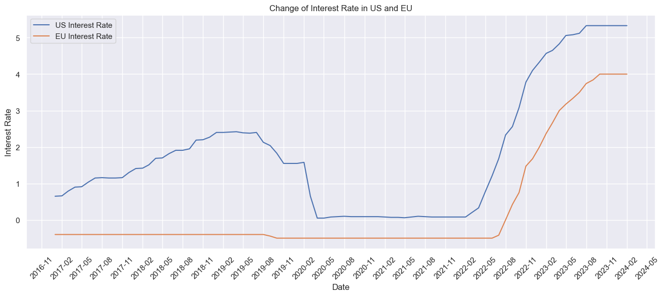
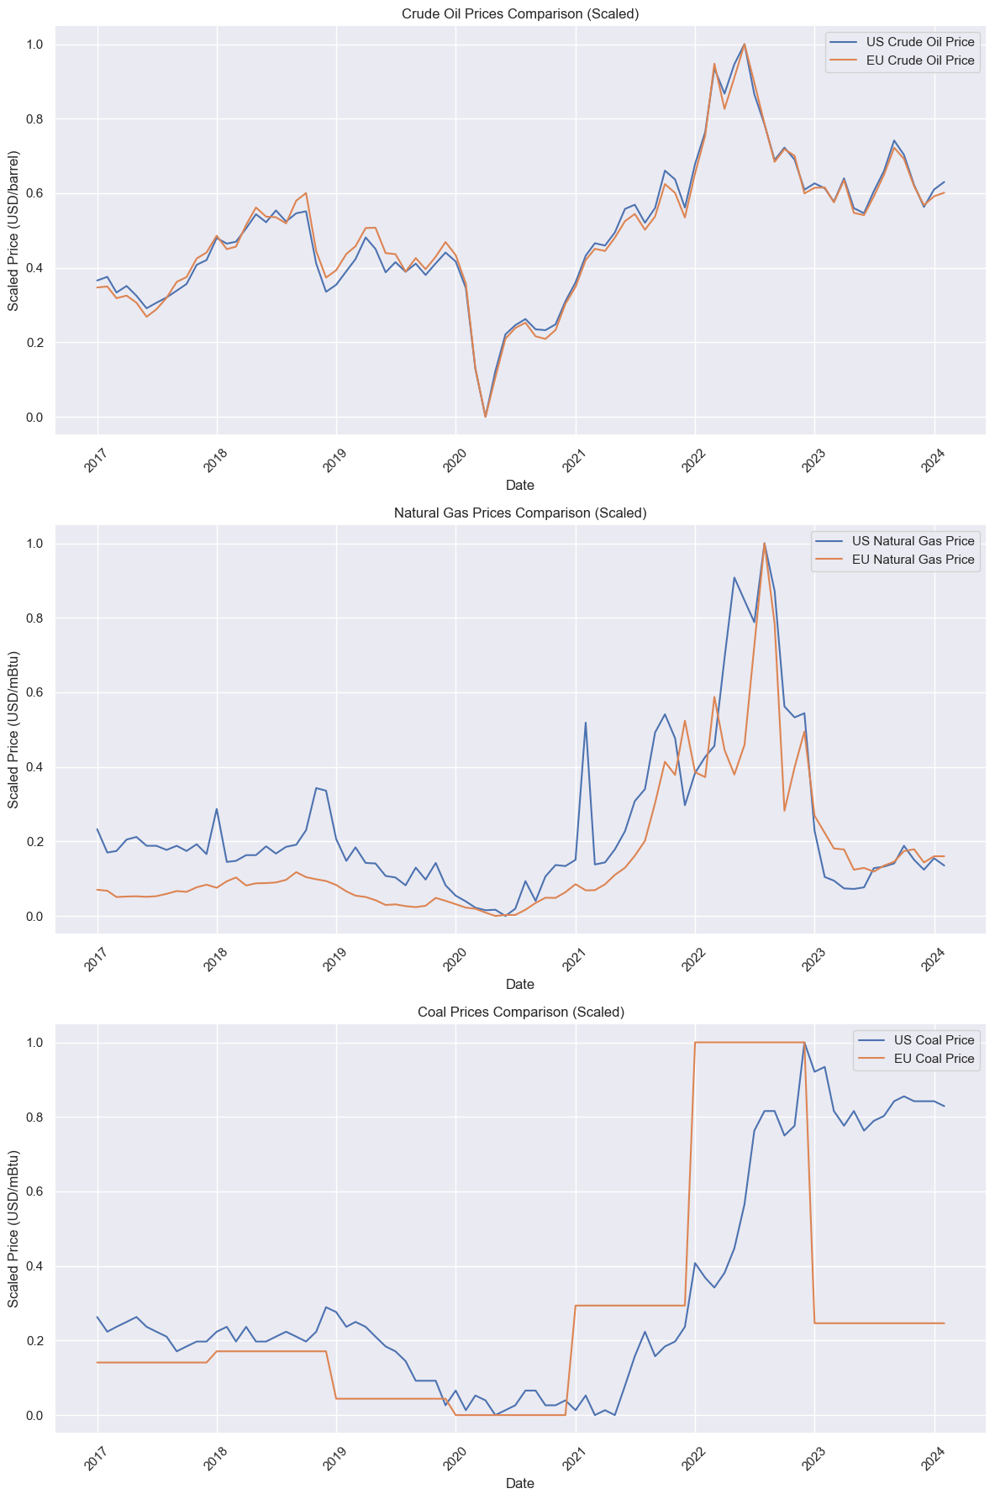
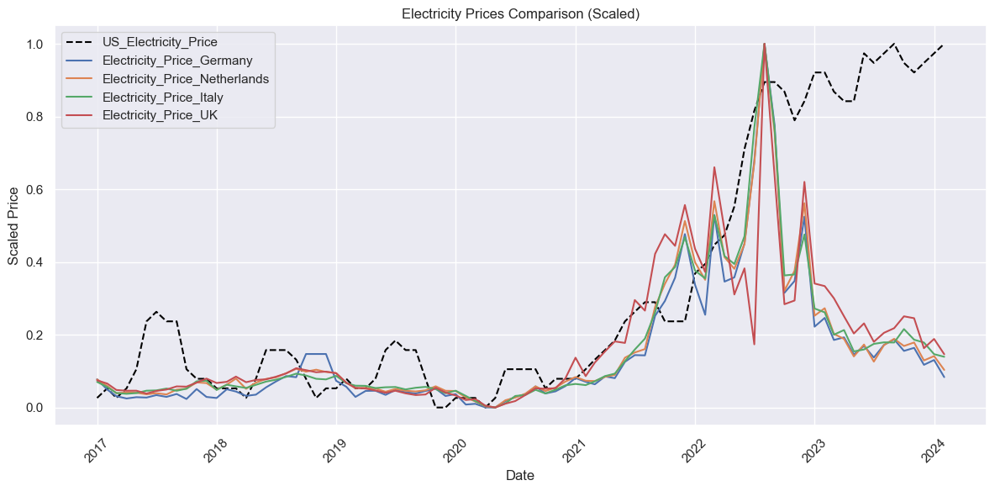
interest rates over time in both markets -us and eu, have evolved very similarly.
Up until the first half of 2022, US electricity prices changed in a very similar manner to those in Europe.
All of the energy commodity have strong positive correlation between US and Europe, we can see the same trends.

Slide 23
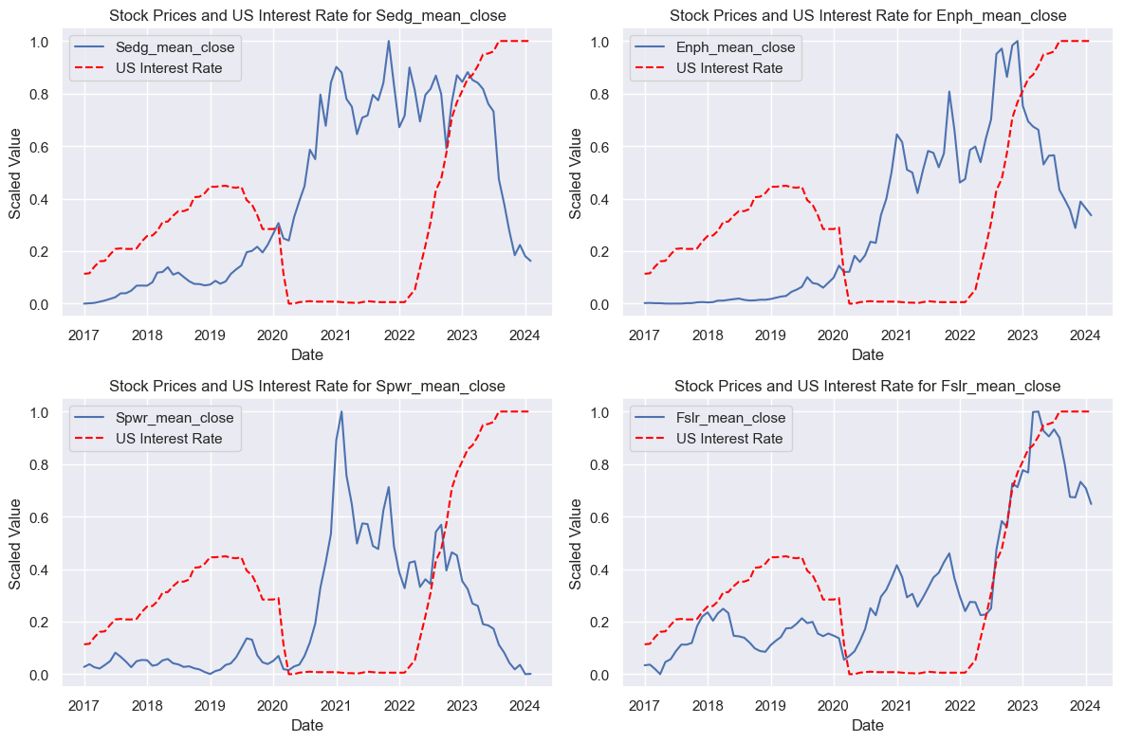
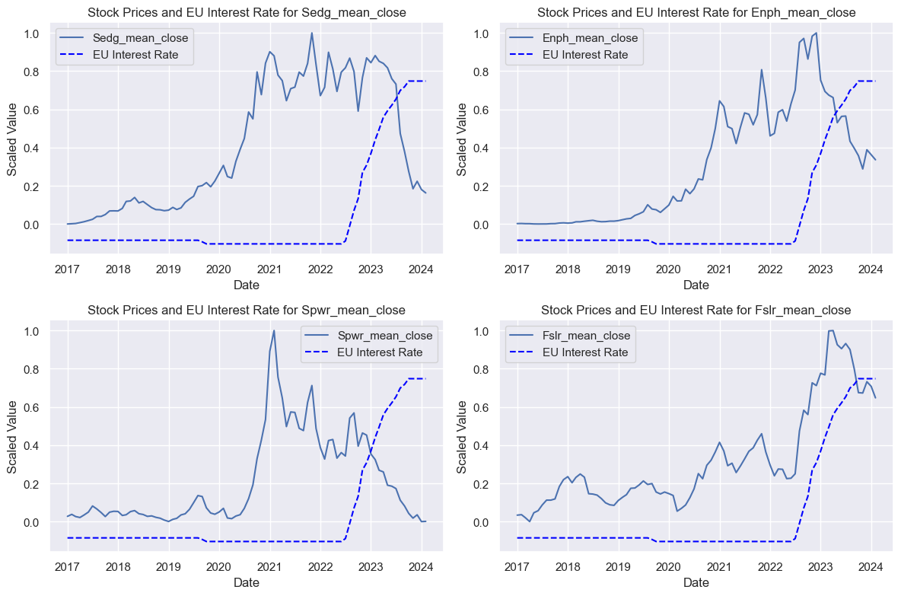
The impact of interest rates on stock prices
The strongest negative correlation (-0.82 - -0.97) between rising interest rates and falling stock prices.

Slide 24
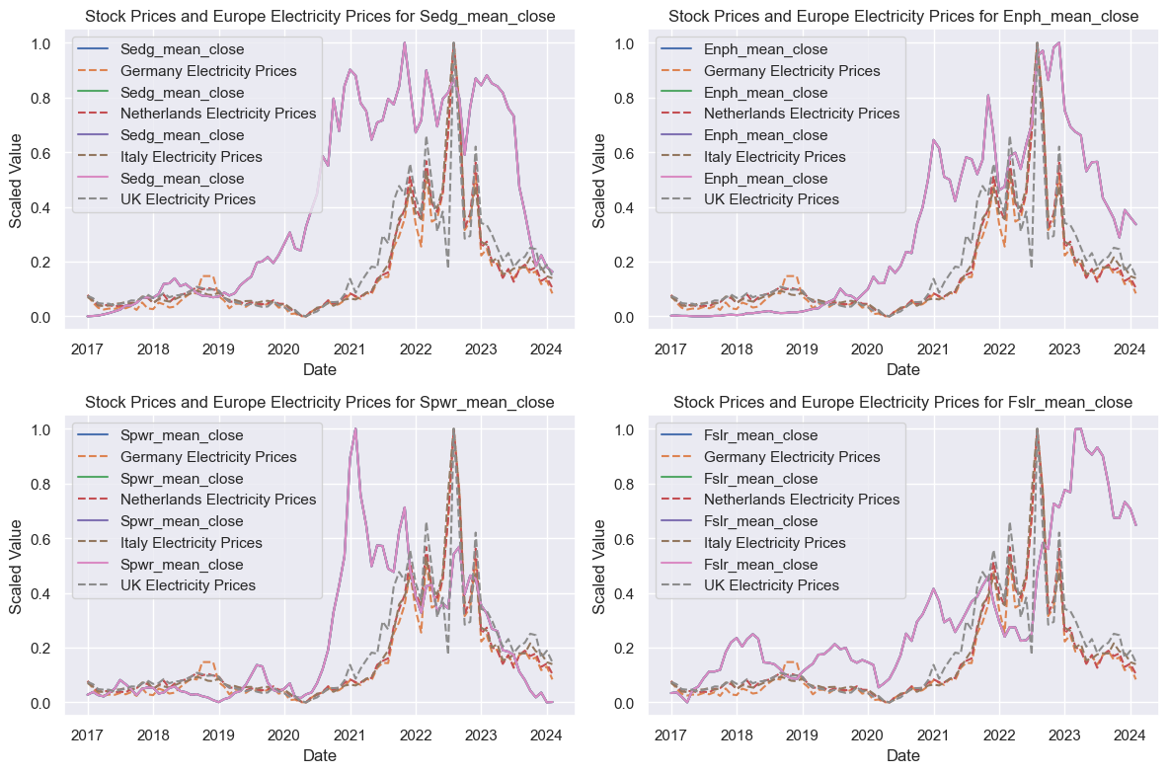
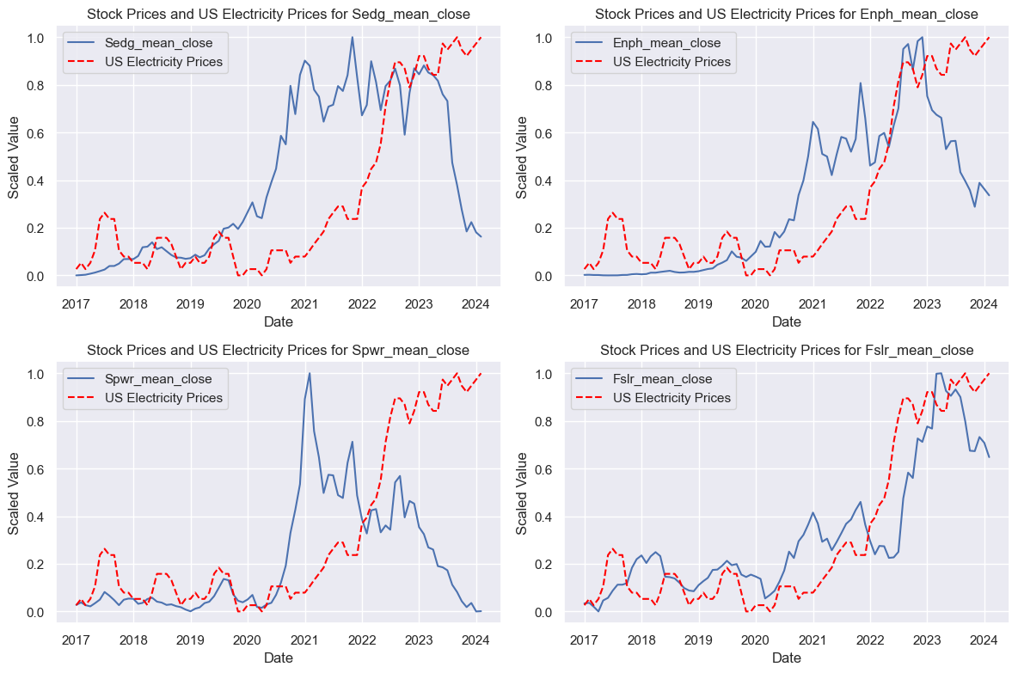
The impact of electricity prices on stock prices
In Europe, there is a positive correlation between increasing electricity prices and rising company shares. We notice that the peaks in electricity prices and shares were reached approximately simultaneously in Enphase Energy and SolarEdge.
This is explained by the fact that when the price of electricity rises, people switch to alternative energy sources.
As for the American market, there was also a positive relationship throughout the entire period. However, in the last year, we observed a negative correlation. During this last year, interest rates had a more pronounced impact on stock prices. Most people install solar panels on credit, but nominally interest rates in America are higher compared to Europe. Additionally, internal reforms within the US electricity system, such as Nem 3.0 in California, also played a significant role.

Slide 25
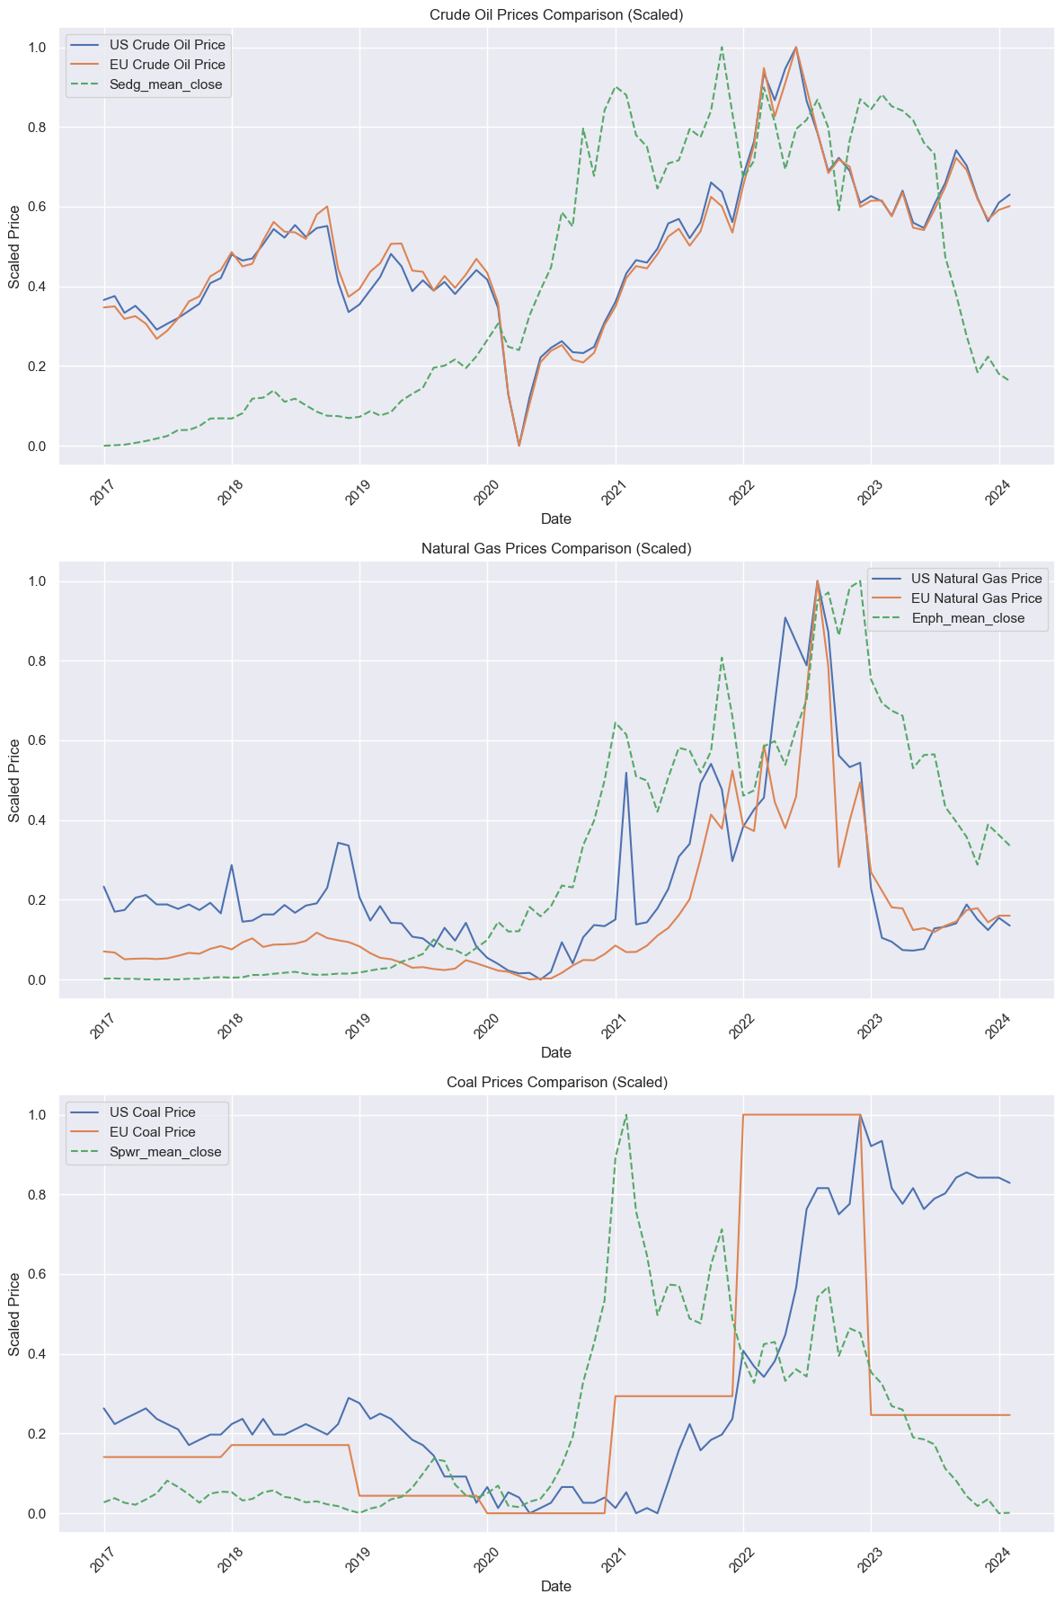
The impact of energy commodity on stock prices
There is a positive correlation. The reasons for that is because this is a competitive energy prices; and this is substitute goods.
As for coal, we observe a lower correlation. The reason for this is that there are far fewer power plants that operate on coal due to its significant air pollution. Its contribution to the cost of 1 kW of energy is much lower. However, coal does have a greater impact on the price of electricity, consequently affecting the price of solar energy.

Slide 26
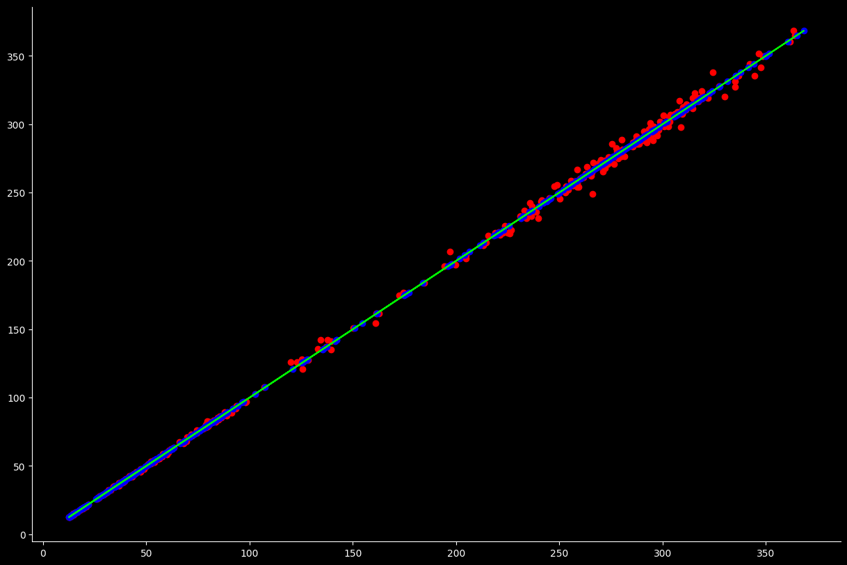
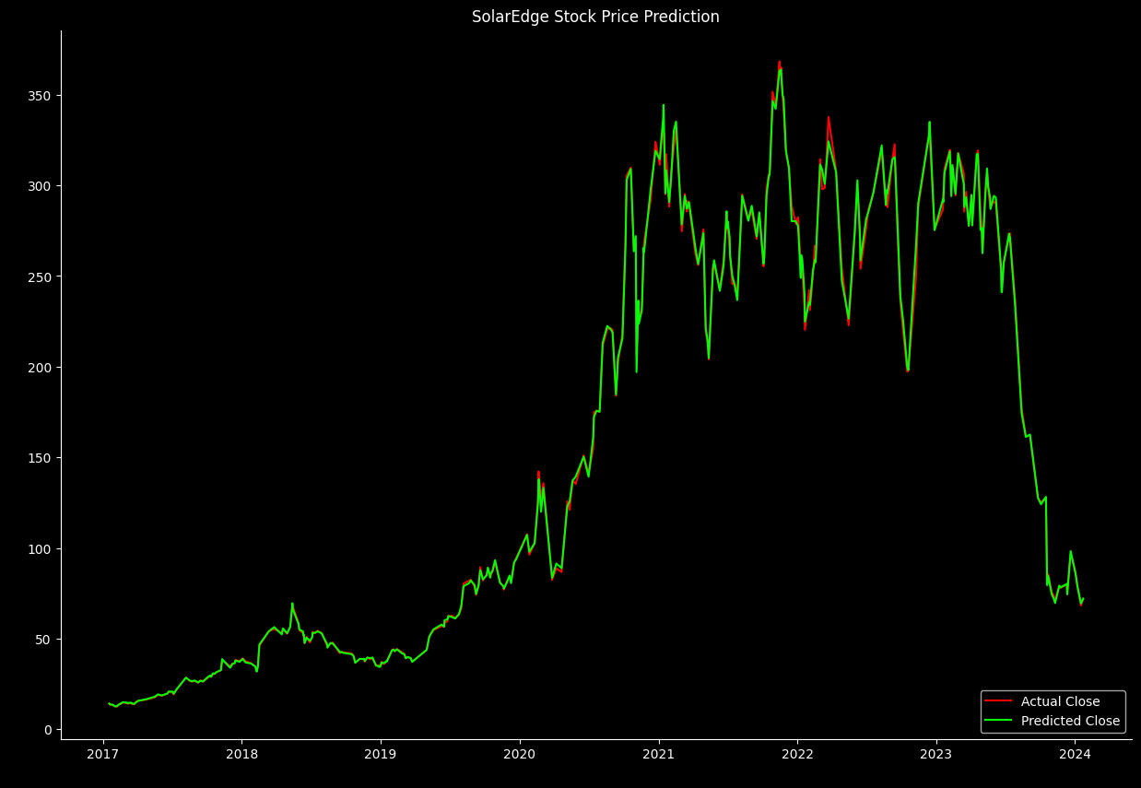
a Solaredge stock price prediction using a linear regression model
MSE 8.494 RMSE 2.914 MAE 1.756 MAPE 0.011 R2 Score : 0.999
Blue Points: These represent the actual values of the target variable (y_test).
Red Points: These represent the predicted values of the target variable (y_pred).
Green Line: This line represents a perfect prediction scenario where the predicted values perfectly match the actual values. It's a reference line where y_pred equals y_test.

Slide 27
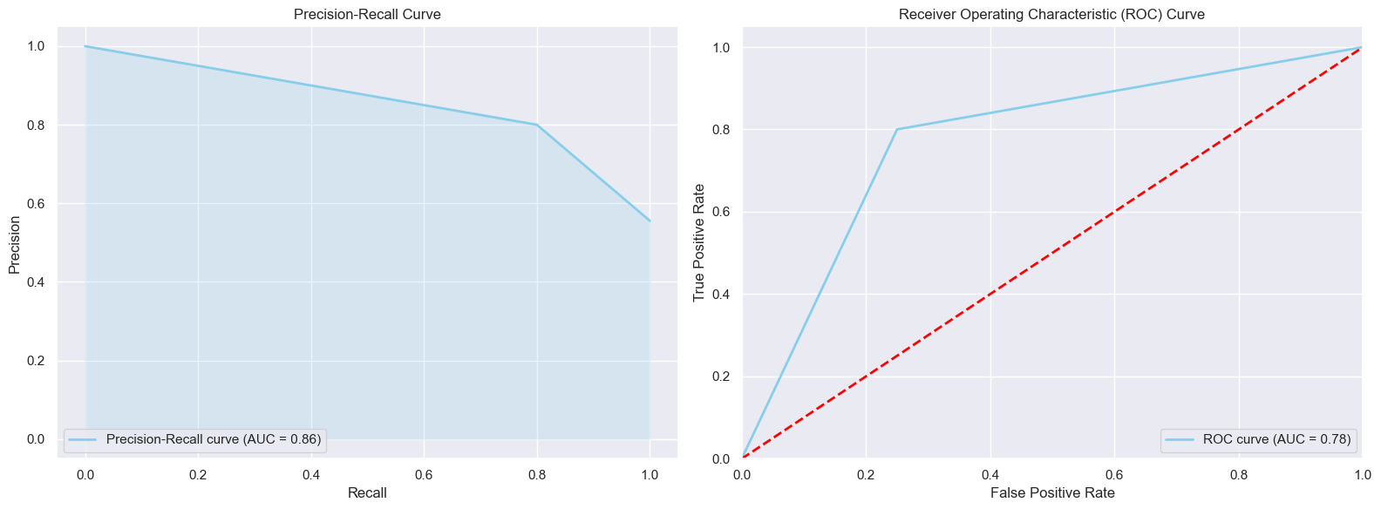
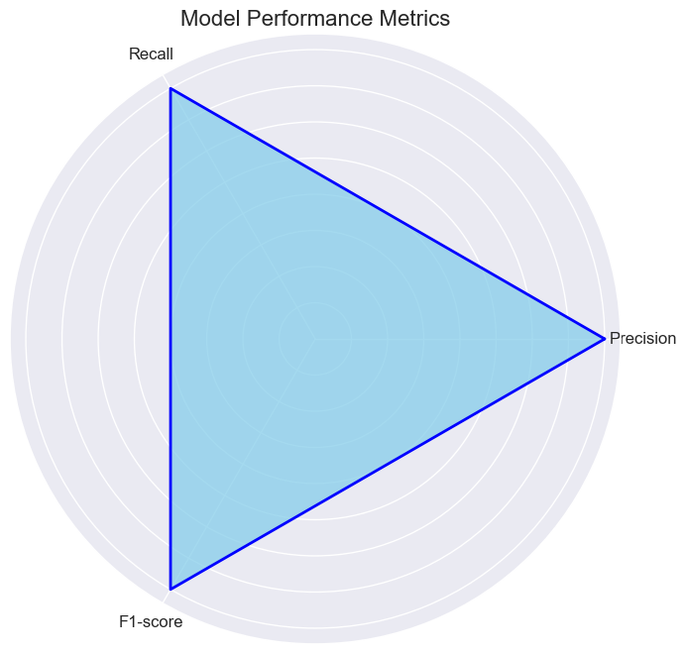
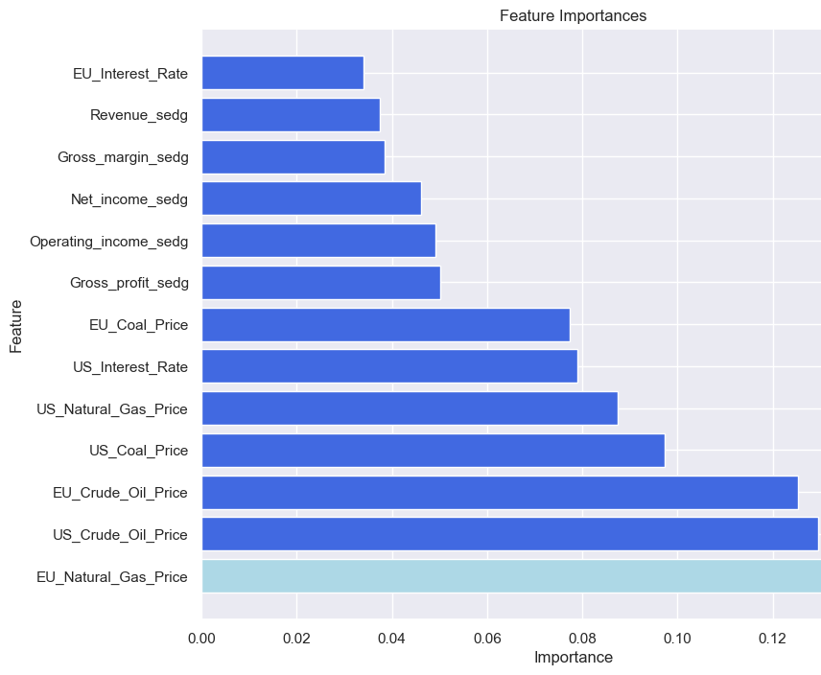
Random forest model
Let's frame our problem as a classification task, we'll predict whether the stock price will increase, decrease, or remain the same.
Natural gas has the most significant influence on stock prices. This is attributed to the Russian-Ukrainian conflict, as Europe had previously relied on Russian gas imports.
Precision: 0.8 Recall: 0.8 F1-score:
Accuracy : 0.77

Slide 28

Conclusion
Thorough analysis of SolarEcon Insight project revealed crucial insights into the solar energy sector.
Utilizing linear regression and random forest models for stock price prediction showcased promising results, with future plans to expand modeling techniques.
Financial statement analysis of SolarEdge highlighted correlations between financial health and market performance, emphasizing the need for ongoing monitoring.
Integration of additional metrics like interest rates, electricity prices, and energy commodity prices enhances predictive capabilities and aids decision-making.
In reality, many more factors influence prices in the solar industry (such as price of batteries, various regulations and subsidies in specific countries. However, the indicators I selected have the most significant influence; these are the major factors affecting the prices of solar energy. Therefore, by understanding these factors, companies can predict future market dynamics and anticipate changes in their stock prices.
While it is true that people increasingly recognize the benefits of alternative energy and desire to reduce environmental pollution, the economic aspect remains predominant today.

